Slide 1
MongoDB Operators
Rahul
161126

Slide 2
Comparison Operators
$gt
$lt
$gte
$lte
$eq
$in
$nin
$ne

Slide 3
db.movies.find({runtime: {$ne :60}}).count()
70
> db.movies.find({runtime: {$gt :60}}).count()
2
> db.movies.find({runtime: {$gte :60}}).count()
172
> db.movies.find({runtime: {$lt :60}}).count()
68
> db.movies.find({runtime: {$lte :60}}).count()
238
> db.movies.find({runtime: {$eq :60}}).count()
170
> db.movies.find({runtime: {$in :[30,60]}}).count()
232
> db.movies.find({runtime: {$nin :[30,60]}}).count()

Slide 4
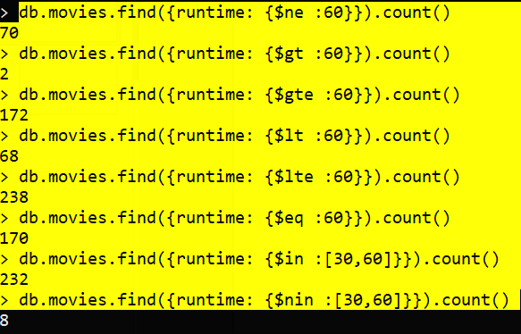

Slide 5
Element
$type
$exists

Slide 6
db.contacts.findOne({ phone: {$type: "string"}})
db.contacts.findOne({email: {$exists:false}})

Slide 7
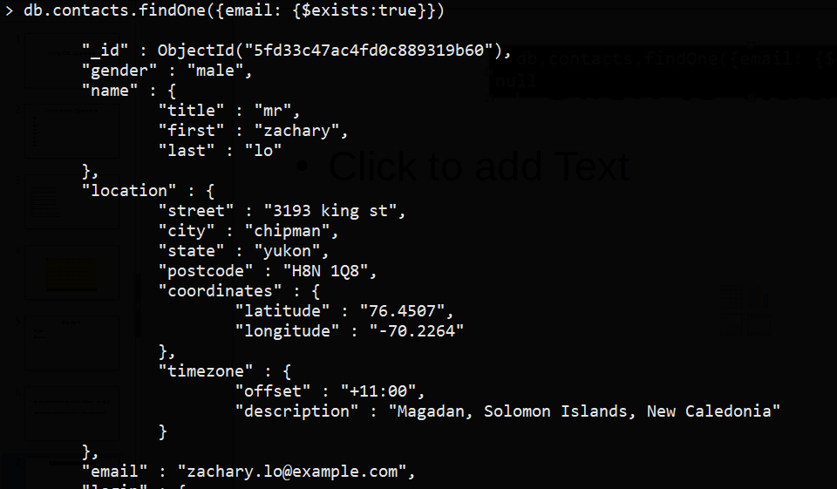

Slide 8
Array Operations
$size
$all
$elemMatch

Slide 9
> db.movies.find({"schedule.days" :{$size:2}},{"schedule.days":1})
{ "_id" : ObjectId("5fd2f3f0b1d9f6506b5df91e"), "schedule" : { "days" : [ "Monday", "Tuesday" ] } }

Slide 10
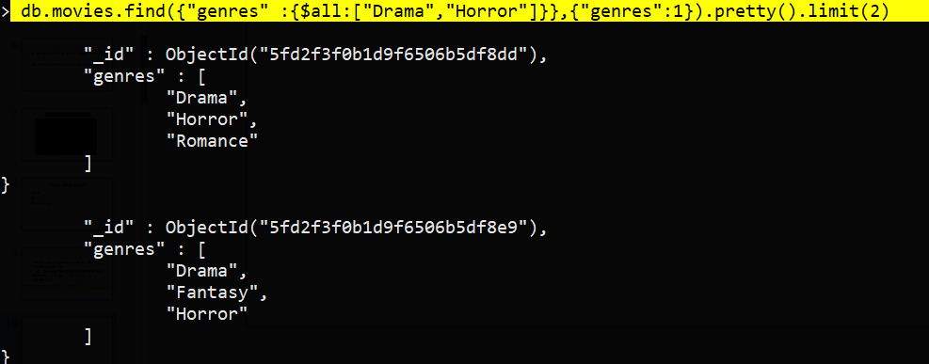
db.movies.find({"genres" :{$all:["Drama","Horror"]}},{"genres":1}).pretty().limit(2)

Slide 11
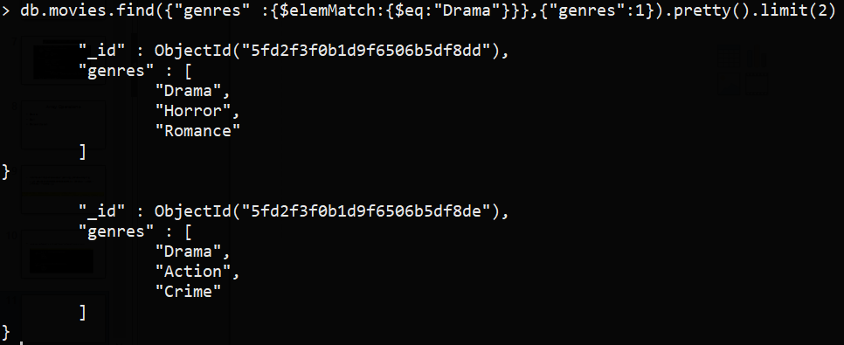
db.movies.find({"genres" :{$elemMatch:{$eq:"Drama"}}},{"genres":1}).pretty().limit(2)

